Slide 1
Advanced Data Science with IBM Specialization
Customer demographics and sales
in THE United States
VIDEO https://rumble.com/veq9tr-advanced-data-science-with-ibmspecialization-monica-bustamante-.html

Slide 2

process models for data science CRISP-DM

Slide 3
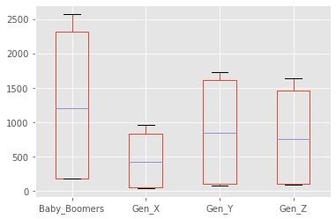
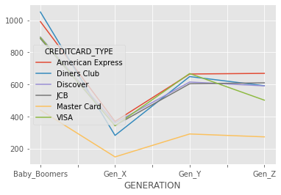
Customer Analysis
By Generation
By gender

Slide 4
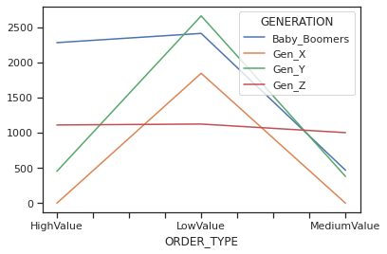
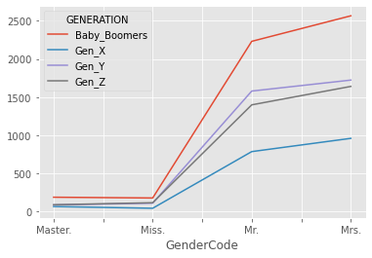
Customer analysis
by order type
By gender and generation

Slide 5
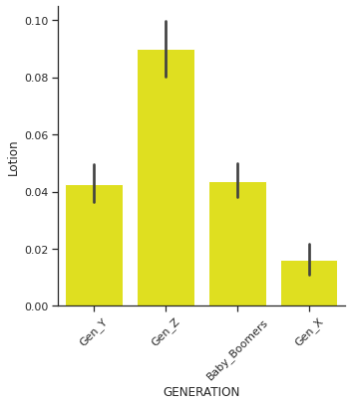
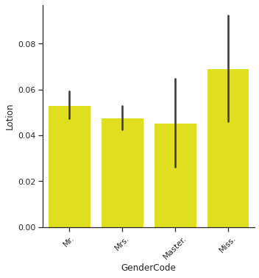
Product Analysis
by generation
by gender

Slide 6
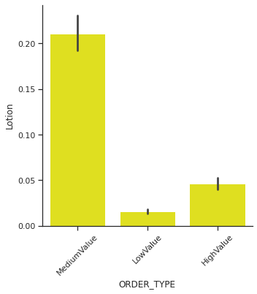
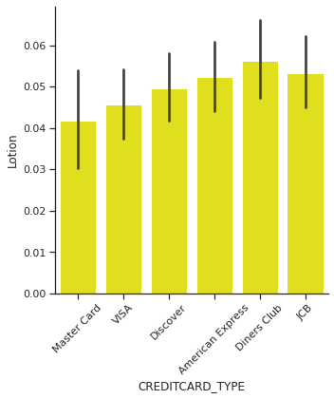
Product analysis
By order type
By credit card type

Slide 7
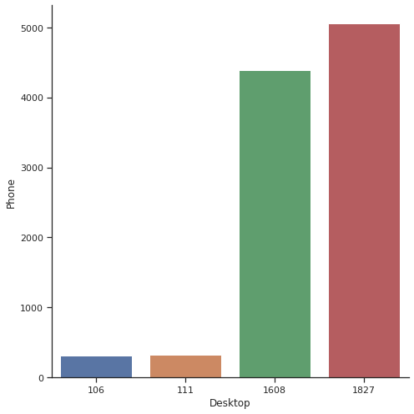
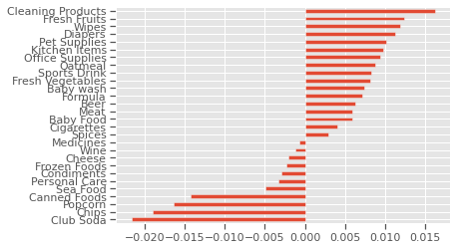
conclusion
By purchase point
Product preference

